Slide 1

Digital Portfolio
Student name:
Rahela Kafiya
Register no and NMID:
24134130500122015 and E0A61032B5A4FEFB0A84DC2AB5D0201B
Department :
Bachelor of computer applications
College: Deen college of arts and science

Slide 2


Project Title
Student Digital Portfolio

Slide 3
AGENDA
1. Problem Statement
2. Project Overview
3. End Users
4. Tools and Technologies
5. Portfolio design and Layout
6. Features and Functionality
7. Results and Screenshot
8. Conclusion
9. Github Link

Slide 4
Problem Statement
●In today’s digital era, professionals and students need an effective way to showcase their skills, projects, and experiences to potential employers, clients, or collaborators. Traditional resumes and paper-based portfolios are limited, static, and not interactive.
●To solve this, we need a personal portfolio website that presents a user’s profile in an engaging, interactive, and professional manner. This website should allow dynamic updates, be visually appealing, and provide a central place to highlight About Me, Skills, Projects, Education, Experience, and Contact Information.

Slide 5
Project Overview
●Title: Personal Portfolio Website
●Objective: To create a personal portfolio webpage for Rahela Kafiya showcasing her skills, projects, and contact details with a green cursive theme.
●Features:
About Me section with update button
Skills, Projects, Experience, Education
Add Project functionality (JavaScript)
Hobbies & Contact info
●Design: Green theme, cursive fonts, card layout, hover effects.
●Tech Used: HTML (structure), CSS (styling), JavaScript (interactivity).

Slide 6
End Users
Employers & Recruiters
To view Rahela’s skills, projects, and qualifications for job opportunities.
Clients
To check design and development work before hiring for freelance projects.
Teachers & Evaluators
For academic/project submissions and grading.
Peers & Collaborators
Other developers/designers who may want to collaborate.
General Audience
Anyone interested in knowing more about Rahela’s work, hobbies, or contact details.

Slide 7
Tools and Technologies
HTML5 – For webpage structure.
CSS3 – For styling (green theme, cursive fonts, hover effects).
JavaScript (ES6) – For interactivity (update info, add projects).
Acode App (Android) – To write and run the code.
Web Browser (Chrome/Edge/Firefox) – To preview and use the portfolio.

Slide 8
Portfolio design and layout
Theme: Green (light mint background, dark green header/buttons, soft green cards).
Font Style: Cursive (Brush Script MT) for an elegant look.
Header: Name Rahela Kafiya and role Developer & Designer.
Card-Based Layout: Each section (About, Skills, Projects, Experience, Education, Hobbies, Contact) is displayed inside rounded green cards.
Interactivity:Buttons with hover effects.
JavaScript to update “About Me” text and add new projects.
Responsive & Simple: Works smoothly on mobile (Acode app) and browsers.

Slide 9
Features and Functionality
About Me Section – Displays intro; button updates text dynamically.
Skills Section – Lists technical & design skills.
Projects Section – Shows sample projects; allows adding new projects via JavaScript.
Experience Section – Highlights internships/freelance work.
Education Section – Shows academic background & certifications.
Hobbies Section – Adds a personal touch with interests.
Contact Section – Email for communication.
Design – Green theme, cursive font, card layout with hover effects.

Slide 10
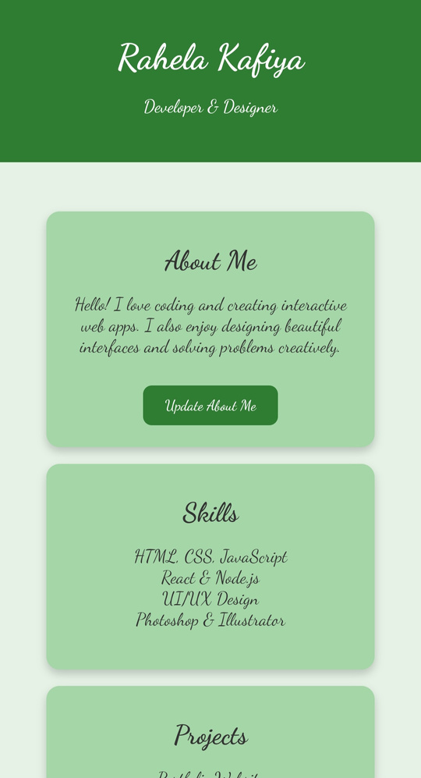
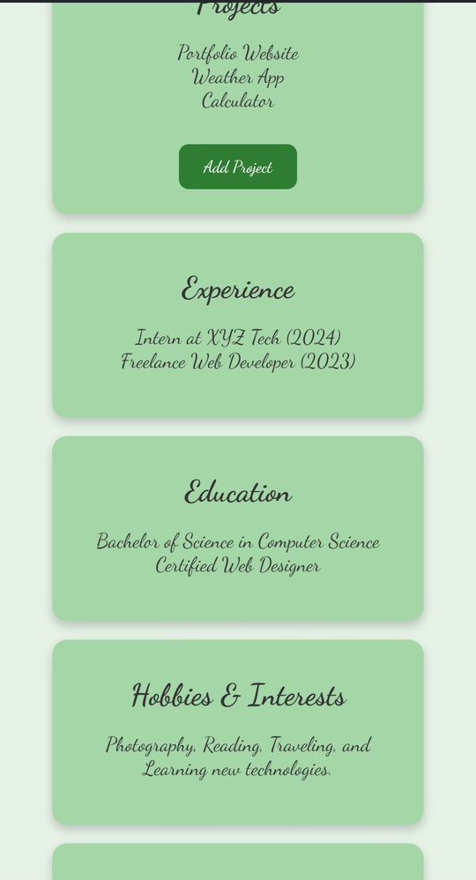
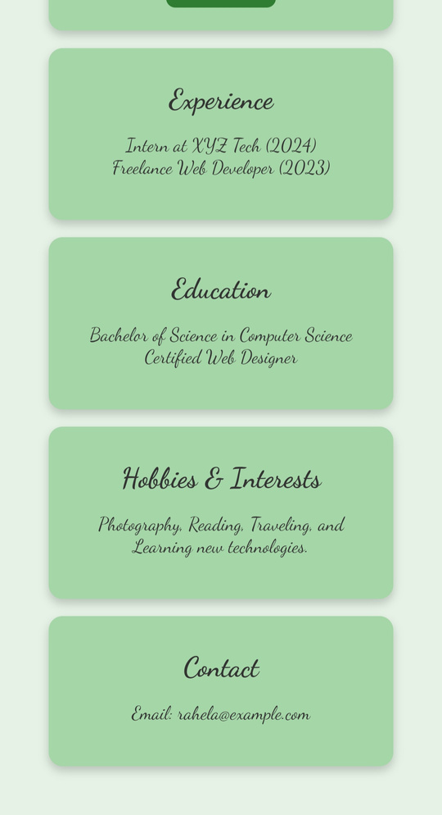
Results and Screenshot

Slide 11
Conclusion
The Personal Portfolio Website of Rahela Kafiya was successfully developed using HTML, CSS, and JavaScript with a green cursive theme. It effectively presents personal details, skills, projects, and contact information in an interactive and user-friendly way. The project demonstrates creativity in design, functionality through dynamic features, and practical use for career, academic, and freelance purposes.

Slide 12
Github link
https://github.com/RahelaKafiya/Rahela-TNSDC-FWD-DP.git

